Slide 1

Find All My Friends Crossing Platform Borders
Projektvorstellung
Eingebettete Betriebssysteme
8. Feburar 2012

Slide 2

Push Notifications
iOS
Application-Limitations:
application not active every time
no background threads
no running at standby

Slide 3
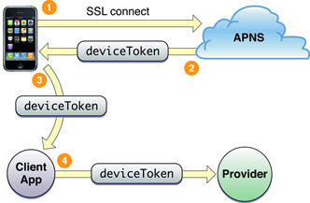
Push Notifications Details
iOS
persistent IP connection
store and forward principe
one notification per device per user
secure authentication
on port 5233
message consits of:
token
payload (json RFC 4627 )
Source: Apple Documentation

Slide 4
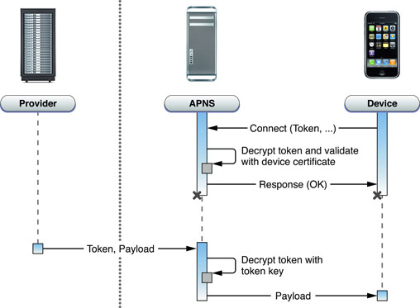
Push Notifications: Send Message
iOS
Source: Apple Documentation

Slide 5
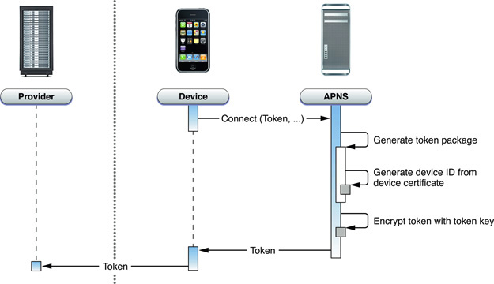
Push Notifications: Receive Message
iOS
Source: Apple Documentation

Slide 6

Push Notifications: Message Format
iOS
Message Structure:
length of full message 256 Byte
message header and token → Binary
message payload → JSON
Feedback Service:
message send, when the application is deleted from phone
binary message

